Slide 1
Lab report:
Results

Slide 2
Describe and Report
The Results section…
Usually the shortest section
Is strictly descriptive
Raw data (to an extent)
Calculated data
Don’t analyze results; just report them.

Slide 3
Data tables
You must have one of these!
Caption above the table
Table #: Descriptive title
    Appropriate statistics: mean, standard deviation, etc.
    Appropriate units!
E.g. Table 1: Difference in reaction rates among treatments.

Slide 4
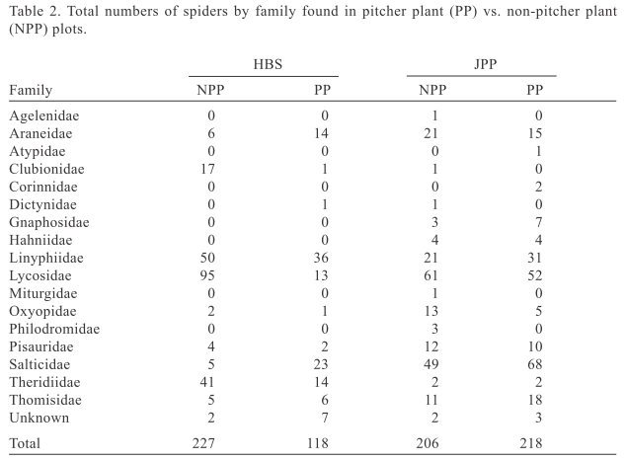

Slide 5
Graphs
You must have one of these!
Follow directions from Lab 2 (pg. 34)
  Figure #: Descriptive Title (above graph)
  Error bars (std dev)
  Axes labels with units
  Independent variable on x-axis
  Dependent variable on y-axis
  Differentiated lines (black and white?)
  Legend.

Slide 6
Graphs and Tables
The graphs and tables should be comprehensible even without a description.

Slide 7
Citing graphs and tables
You should cite tables and graphs
  e.g.: “The reaction rate of each treatment differed significantly (Fig. 1).”
  or
  “The various treatments produced a variety of different reaction rates (Table 1).”

Slide 8
Today’s activities
Class activity on finding errors in graphs
Peer review of methods

Slide 9
No title
No error bars

Slide 10
No legend

Slide 11
No units on axes

Slide 12
No figure #

Slide 13
No axes titles
No error bars

Slide 14
Non-descriptive title

